Slide 1

Weekly report <E-bill>
Naveen, Programmer
11.03.2021

Slide 2
Project goals and vision
  Application runs smoothly
  Bugs free
  User friendly
  Light weight
Project description
  Android application for Delivery bill
  Registration of Delivery boy
  Delivery boy will get order list
  Acknowledgement by Delivery Boy

Slide 3
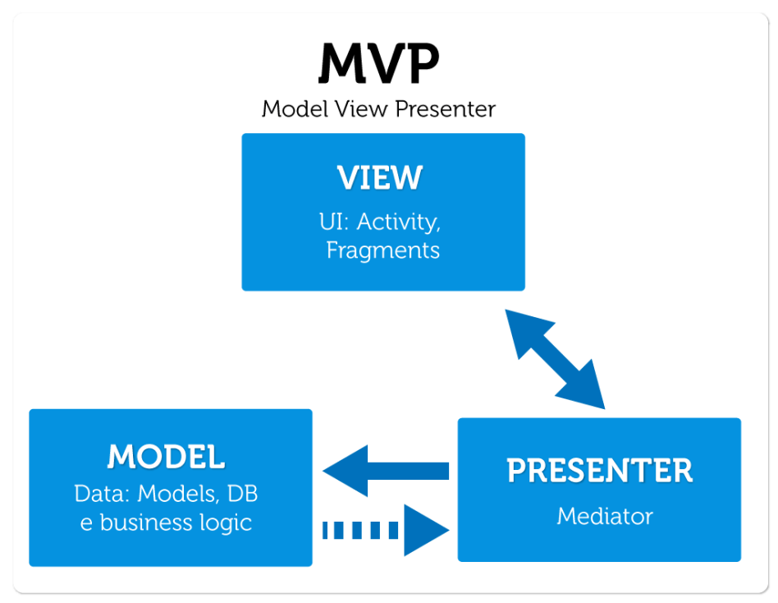
Architecture

Slide 4

Model: the data layer
View: the UI layer, displays data received from Presenter, reacts to user input. On Android, we treat Activities, Fragments, and android.view.View as View from MVP.
Presenter: responds to actions performed on the UI layer, performs tasks on Model objects (using Use Cases), passes results of those tasks to Views

Slide 5

Java
XML
Firebase

Slide 6
Customer
< Evgeny Filippov >
Project/Delivery Manager
<Naveen>
Team <V.A.N.>
Team Lead <Naveen>
Analysts: Chubchik Alexander
Developers:Naveen, Ryleev Vladislav
Testers: Chubchik Alexander
CMs: Naveen, Chubchik Alexander
Notes:
CRM – customer relationship manager / teacher

Slide 7
Using Email
Vk
Using Whatsapp with team members

Slide 8

Kick off meeting
Statement of work
Design Main activity and Registration activity
40% PMP work done

Slide 9
Past Accomplishments | Plan | Actual
<Task/Milestone> | DD-MM-YYYY | DD-MM-YYYY
Kick of Meeting | 04-03-21 | 27-02-21
SOW | 04-03-21 | 27-02-21
Future Milestones | % | Plan | Forecast
<Task/Milestone> | <n>% | DD-MM-YYYY | DD-MM-YYYY
Develop Project Management Plan (PMP) | 40 | 18-03-21 | 17-03-21
Notes:
Provide milestone tracking data in your own form used in project.
Use proposed table in case you have no special form for milestone tracking

Slide 10

NAVEEN
Completed design of main activity and register activity for the Delivery boy
Coding for 2 activities in java
XML design for 2 activities

Slide 11

Chubchik Alexander
Testing of application

Slide 12

Ryleev Vladislav
Debug application

Slide 13
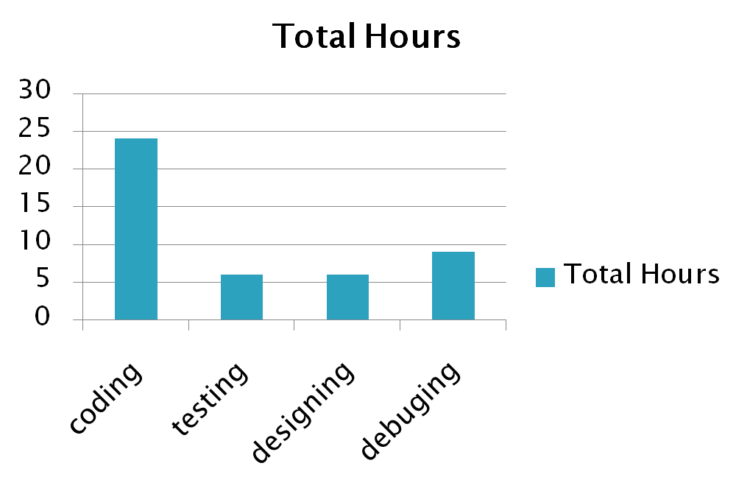

Slide 14
Lack of staff
Load of other tasks

Slide 15
Preparation for the Develop Project Management Plan (PMP)
Add some new activities
New Design for application
Prepare PMP before 18 March

